Slide 1

Sentiment Analysis on Reviews of Breweries using Text Summarization
Gayathri Reddy Sane
L.V. Sai Charan Kothapalli
Aishwarya Ramesh

Slide 2
Introduction
Sentiment analysis of brewery reviews is important for brewery owners and consumers to understand customer satisfaction and opinions.
Existing research has limitations in accurately capturing sentiment from complex natural language reviews containing sarcasm, technical jargon etc.
This project proposes using advanced NLP techniques like Large Language Models (e.g. BERT) and Deep Learning to classify brewery text reviews as positive, negative or neutral.
Machine learning models will be developed to detect sentiment trends and incorporate contextual cues for more robust analysis.
The project aims to contribute to the growing field of domain-specific sentiment analysis by providing a reliable approach to classify brewery review sentiment with greater nuance.

Slide 3
Importance of the Problem
Sentiment analysis extracts and understands sentiments from text using NLP and AI to categorize opinions as positive, negative or neutral. It provides business intelligence for decision making.
Sentiment analysis and sentiment classification are two techniques used in opinion mining.
Sentiment analysis of brewery reviews is valuable for brewery owners to understand customer satisfaction, and for consumers to make informed decisions.
This project will enhance sentiment analysis in the brewery review domain specifically, adding to knowledge in specialized sentiment analysis.
Though existing research on sentiment analysis is extensive, there is a need to make techniques more accurate and interpretable. Sentiment analysis has immense value across situations.

Slide 4
Approach
Data Collection
Data Preprocessing
Model Development
Model Training and Evaluation
Testing & Analysis
Results
Conclusion

Slide 5
Data Collection
Yelp reviews were scraped as the data source using Microsoft Power Automate to extract all review pages.
Power Automate creates automated workflows (flows) between different applications, connecting them and automating repetitive processes.
Power Automate enhances productivity through workflow automation and streamlined data integration.
The flows are created from scratch or templates, initiating triggers, customizing actions, mapping parameters, testing, troubleshooting permissions, and monitoring execution.
This automation capability streamlines repetitive processes across applications, allowing seamless workflows for tasks like scraping all pages of Yelp reviews in this case.

Slide 6
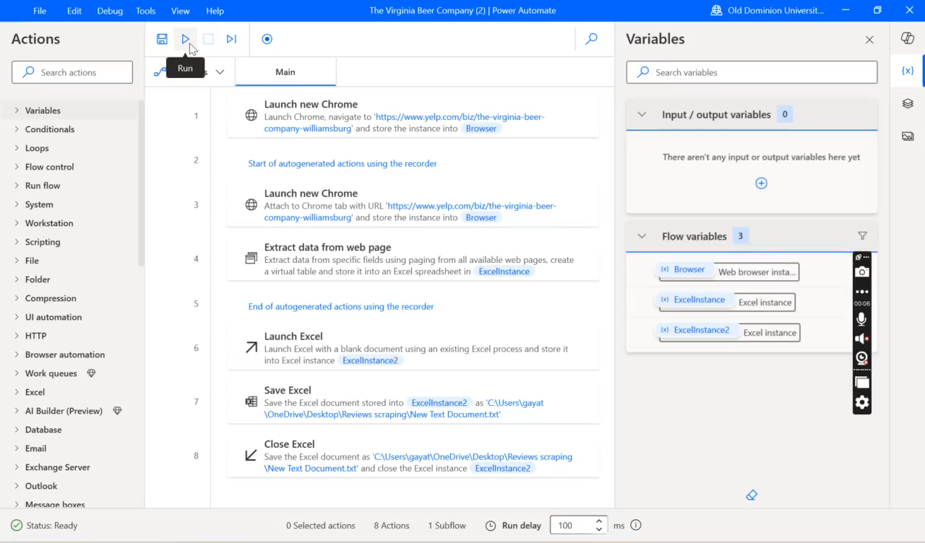

Slide 7
Architectural Schematic
Our model architecture is based on a pre-trained BERT encoder for semantic text representation, with an added output layer for sentiment classification.
Key Components:
Input layer - accepts raw text
Preprocessing - tokenizes text
BERT encoder - encodes semantics into vectors
Output layer - makes sentiment prediction
Output - predicted sentiment label
Data flows sequentially through each component to produce the sentiment label output.
Additionally, using a pre-trained BERT model allows us to leverage transfer learning rather than training from scratch, enabling faster experimentation and avoiding extensive computational requirements.
Finally, BERT has achieved state-of-the-art results on sentiment analysis and other NLP tasks, demonstrating effectiveness for text classification.

Slide 8
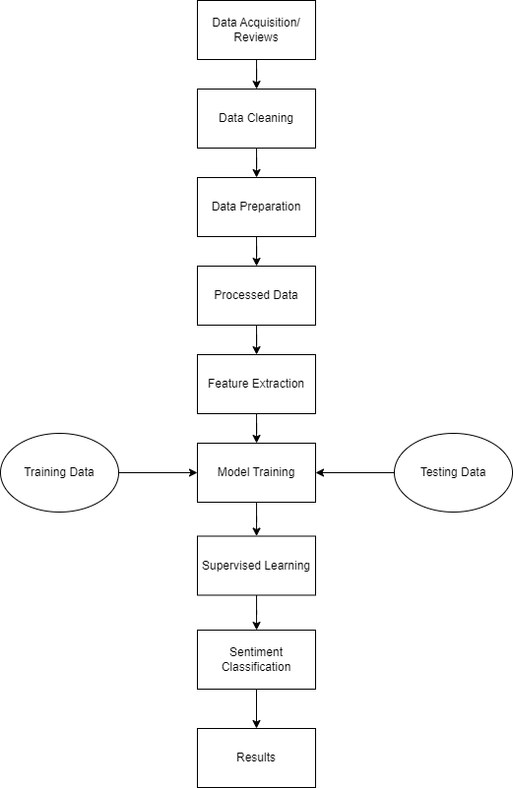
Architectural Schematic

Slide 9
Model Training and Evaluation
The key information on model training and evaluation:
Model Training
Hardware
CPU: Intel core i7, 1 GPU
16GB RAM for faster data processing
Python environment: Jupyter Notebook, CUDA 10.1
Hyperparameters
BERT Base uncased pre-trained model
Batch size: 16
Learning rate: 2e-5
Number of epochs: 3
Model Evaluation
Data Split
80% training set for model to learn
20% testing set to evaluate model performance
Evaluation Metrics
Precision – the proportion of correct positive predictions
Recall – the proportion of actual positives predicted correctly
F1-score - harmony mean of precision and recall
Accuracy - overall categorization accuracy

Slide 10
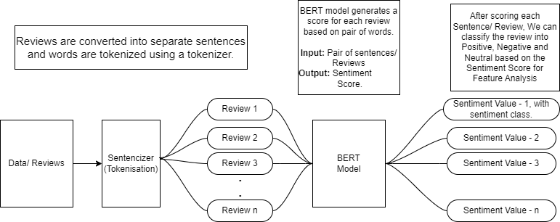
Model Training and Evaluation

Slide 11
Results
Output File
Lexicon method accuracy: 77.1%
Aspect-based analysis: 92.2%
Feature-based analysis: 86.4%
This paper provided a comprehensive overview of the current state and future directions in the field of Sentiment Analysis, highlighting the significant advances and identifying areas for further research.

Slide 12
Conclusion
Our project was analyzed using three different methodologies: aspect-based analysis (BERT Model), feature-based analysis, and lexicon-based analysis. From the three mentioned models, we can infer that the aspect-based approach, also referred to as fine-granted opinion mining, was more accurate since the texts were separated into distinct categories and the sentiment value and corresponding class were derived based on the classified texts. This makes it possible for us to precisely classify each review into three categories: positive, negative, and neutral.

